Slide 1
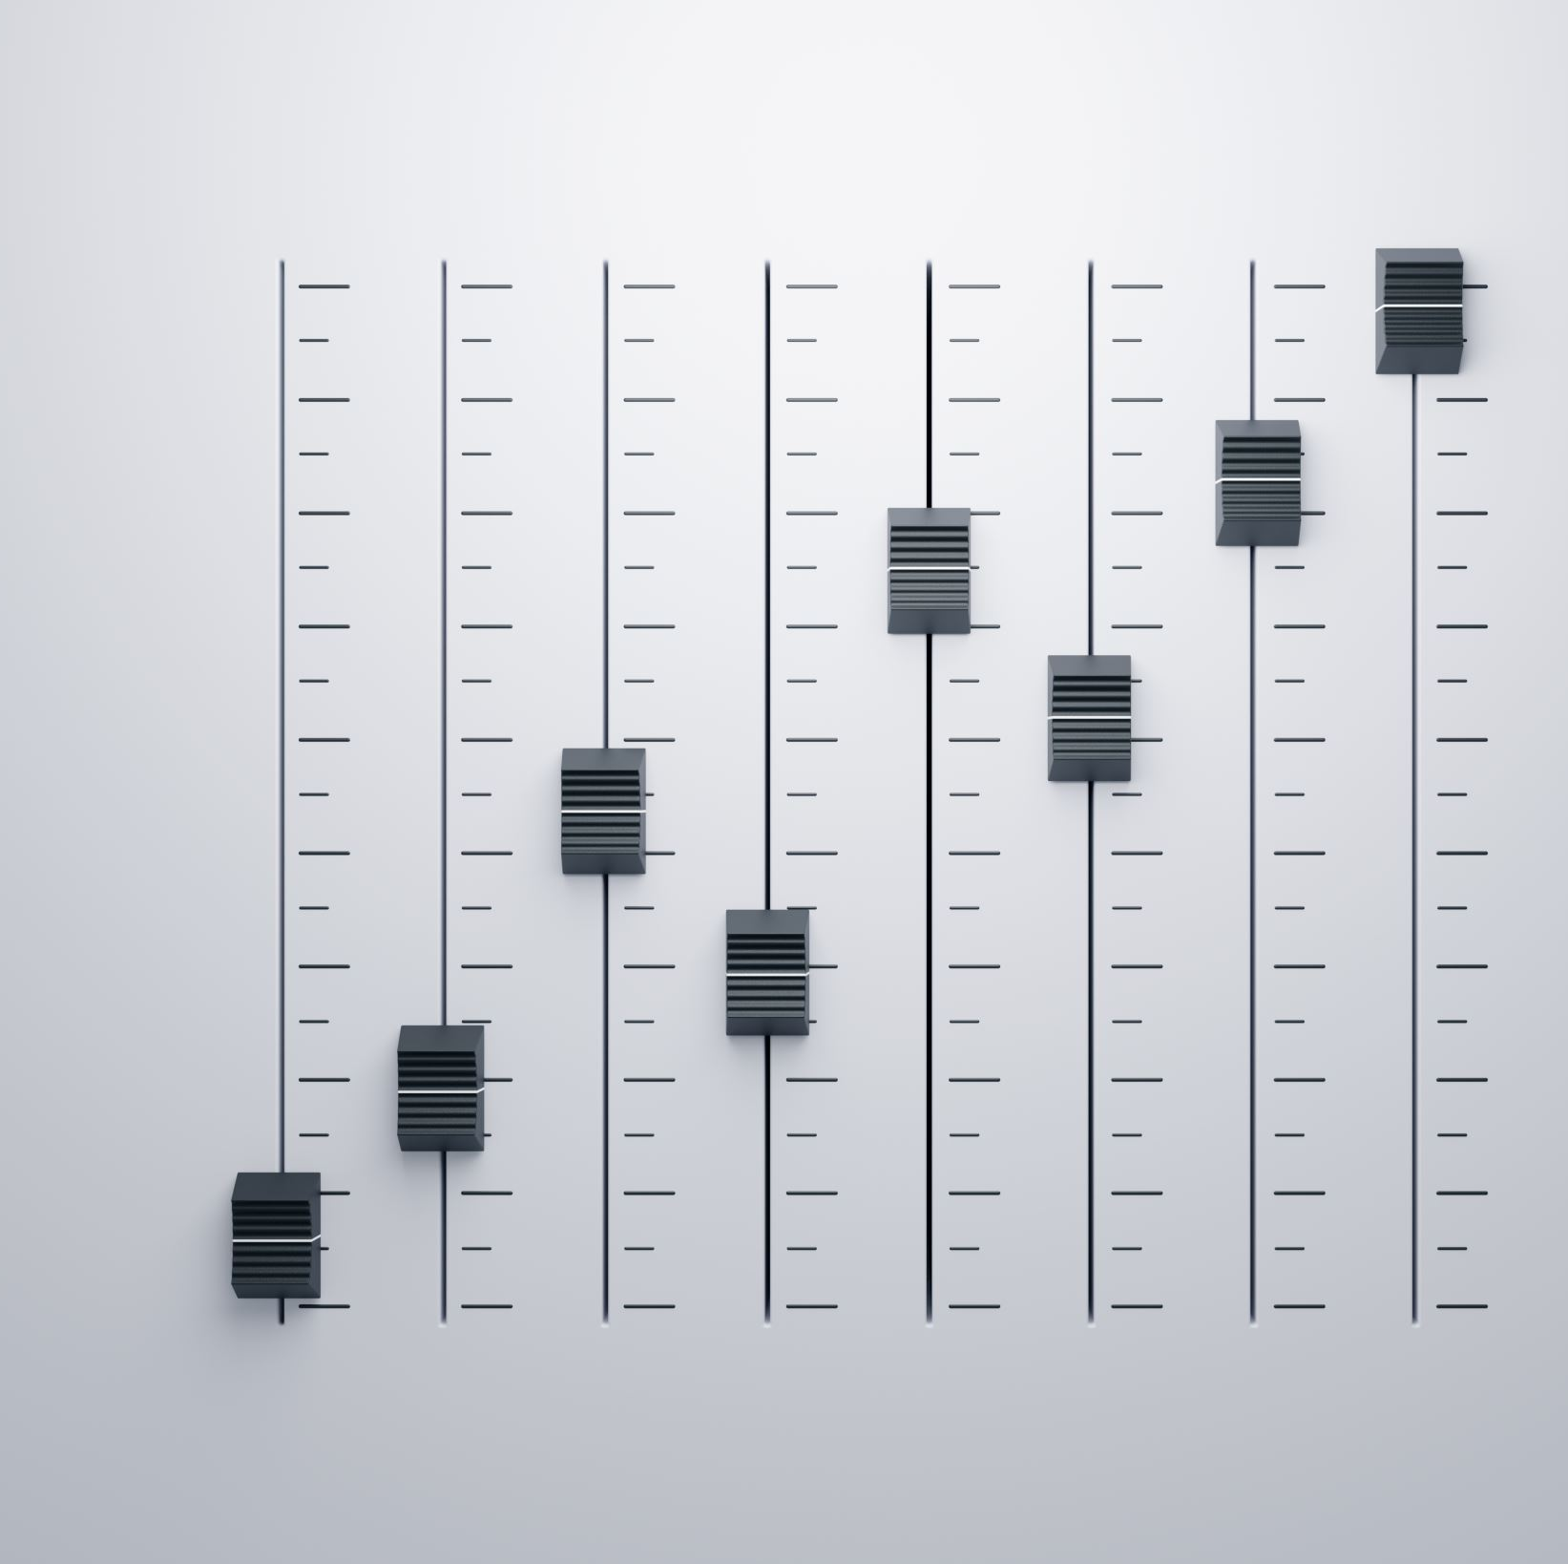
SOUND SIGNAL CLASSIFICATION
Group Members :
Hasan Mert Yalçın - 150119647
Mertcan Çiy - 150119908
Emirhan Meral - 150119649

Slide 2
Contents
What is Sound Signal Classification?
Goal of Sound Signal Classification
What is Mel-frequency cepstrum Coefficients (MFCC)?
Why Convolutional Neural Network (CNN) used for Sound Signal Classification?
What is Librosa library?
Dataset and Dataset Format
Summary
Task Sharing
References

Slide 3
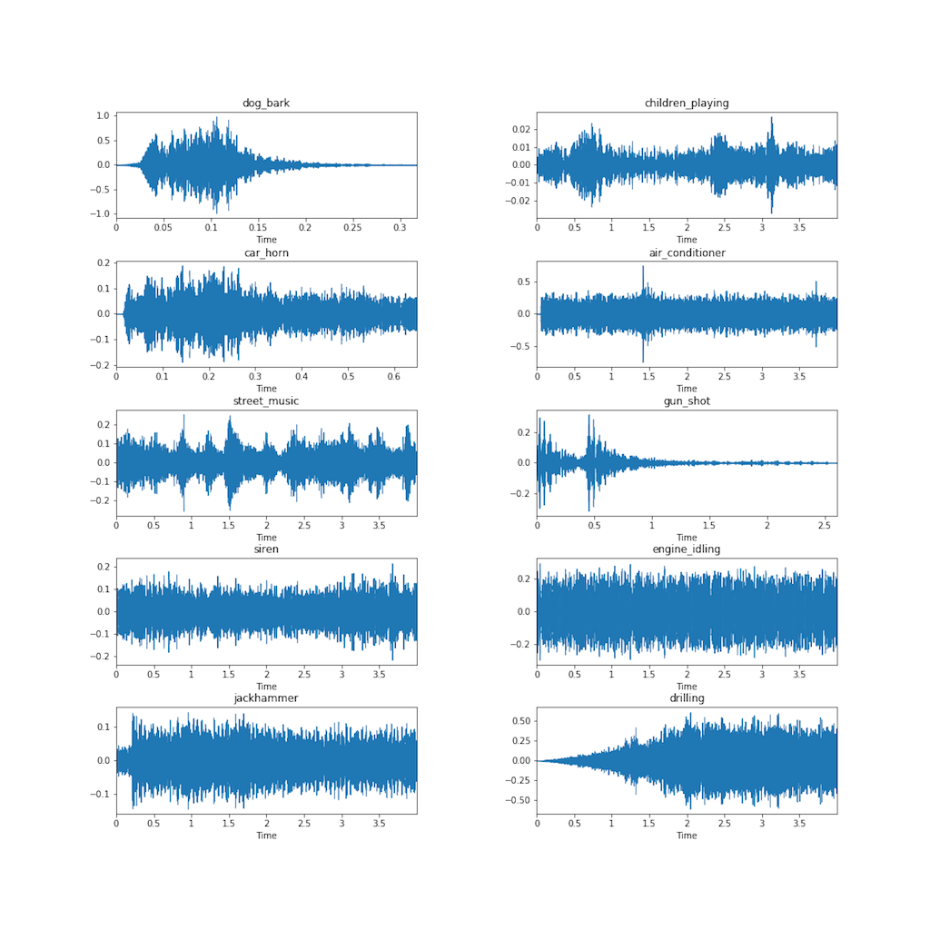
What is Sound Signal Classification?
Audio classification is the process of listening to and analyzing audio recordings. Also known as sound classification, this process is at the heart of a variety of modern AI technology, including virtual assistants, automatic speech recognition and text to speech applications. You can also find it in predictive maintenance, smart home security systems and multimedia indexing and retrieval.

Slide 4

Environmental Sound Classification
Environmental sound classification: Just as the name implies, this is the classification of sounds found within different environments. For example, recognizing automotive and urban sound samples such as car horns, roadwork, sirens, human voices, etc. This is used in security systems to detect sounds like breaking glass.

Slide 5
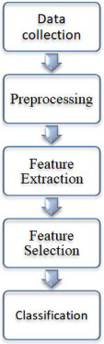
Goal of Environmental Sound Signal Classification
Environmental sound classification (ESC) is one of the upcoming areas of research as most of the traditional studies are focused on speech and music signals. Classifying environmental sounds such as glass breaking, helicopter, baby crying and many more can aid in surveillance systems as well as criminal investigations.

Slide 6
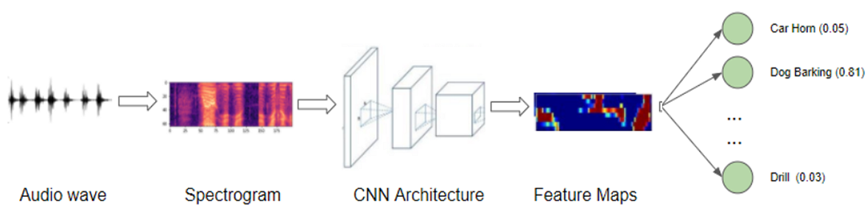
What is Mel-frequency cepstrum Coefficients (MFCC)?
MFCCs are the Mel Frequency Cepstral Coefficients. MFCC takes into account human perception for sensitivity at appropriate frequencies by converting the conventional frequency to Mel Scale and are thus suitable for speech recognition tasks quite well (as they are suitable for understanding humans and the frequency at which humans speak/utter).

Slide 7
Why Convolutional Neural Network (CNN) used for Sound Signal Classification?
Convolutional Neural Networks (CNNs) have proven very effective in image classification and have shown promise for audio classification. Convolutional Neural Networks have been widely adopted as the main building block for end-to-end audio classification models, which aim to learn a direct mapping from audio spectrograms to corresponding labels.

Slide 8
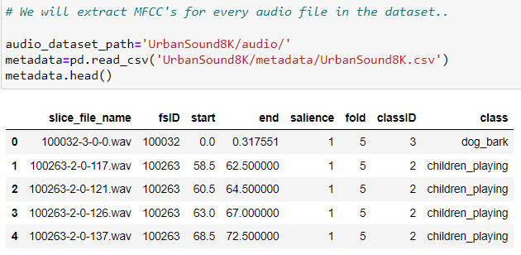
Dataset and Dataset Format
This dataset contains 8732 labeled sound excerpts (<=4s) of urban sounds from 10 classes: air_conditioner, car_horn, children_playing, dog_bark, drilling, engine_idling, gun_shot, jackhammer, siren, and street_music.
In addition to the sound excerpts, a CSV file containing metadata about each excerpt is also provided.
8732 audio files of urban sounds in WAV format.

Slide 9

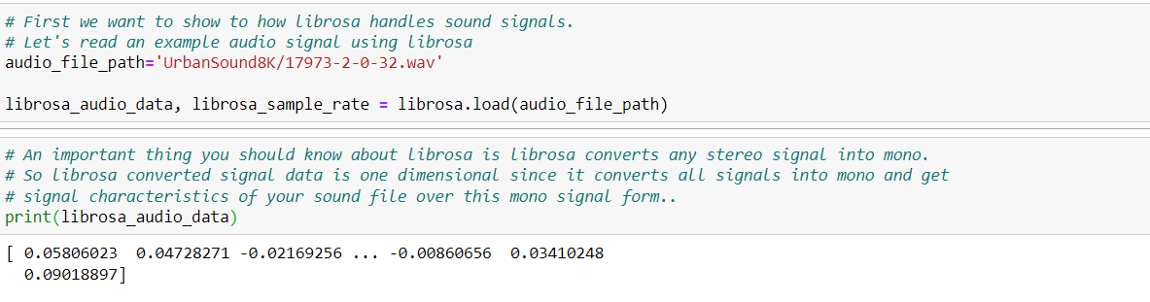
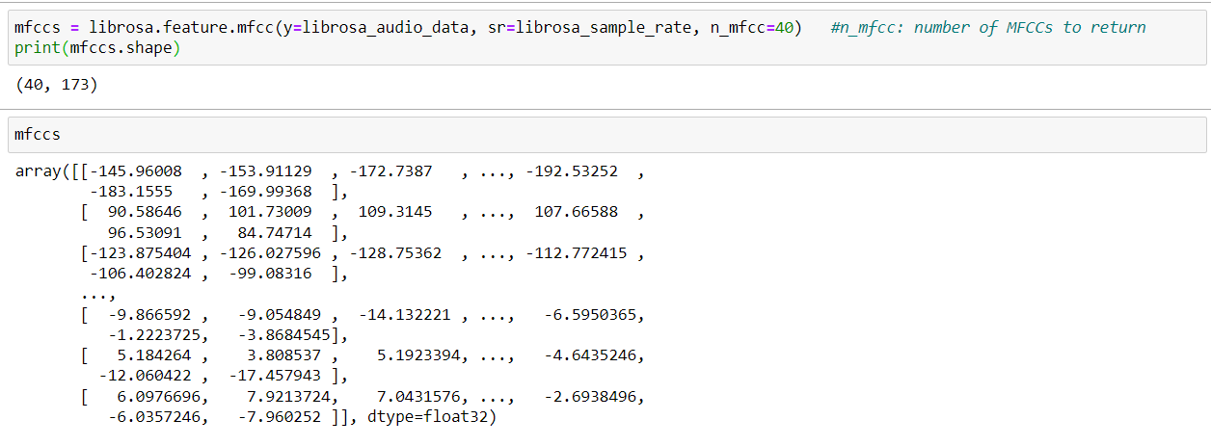
What is Librosa library?
Librosa is valuable Python music and sound investigation library that helps programming designers to fabricate applications for working with sound and music document designs utilizing Python.

Slide 10
Summary
The first thing we learned while doing this project was how audio files are analyzed in deep learning projects.
We have obtained many articles and information on this subject on the Internet. We learned that audio files are not used directly in deep learning algorithms, and we have to extract the MFC attributes of each audio file.
In this project we learned to process audio signals. We learned to do this by detecting the different frequencies in the audio signals and using many mathematical algorithms and using the Python library (Librosa).

Slide 11
Subtask
1) Import the Libraries.
2) Digitase the audio files.
3) Extract MFCC's for every audio file in the dataset.
4) Iterate through every audio file and extract features using Mel-Frequency Cepstral Coefficients
5) Creating X_train and y_train Data Structures.
6) Perform Label Encoding since we need one hot encoded values for output classes in our model (1s and0s)
7) We split dataset as Train and Test
10) Predicting the given audio file.
11) Plotting the given audio file.

Slide 12
Task Sharing

Slide 13
References
[1]“UrbanSound8K,” Urban Sound Datasets. [Online]. Available: https://urbansounddataset.weebly.com/urbansound8k.html.
[2] K. Doshi, “Audio deep learning made simple: Sound classification, step-by-step,” Medium, 21-May-2021. [Online]. Available: https://towardsdatascience.com/audio-deep-learning-made-simple-sound-classification-step-by-step-cebc936bbe5. [Accessed: 30-Nov-2022]
[3] N. Seth, “Introduction to audio classification -emergency vs nonemergency vehicle,” Analytics Vidhya, 12-Jul-2021. [Online]. Available: https://www.analyticsvidhya.com/blog/2021/07/introduction-to-audio-classification-emergency-vs-nonemergency-vehicle/. [Accessed: 30-Nov-2022]
[4] H. Subramanian, AUDIO SIGNAL CLASSIFICATION, Nov. 2004 [Online]. Available: https://www.ee.iitb.ac.in/~esgroup/es_mtech04_sem/es_sem04_paper_04307909.pdf. [Accessed: 30-Nov-2022]
[5] W. Mu, B. Yin, X. Huang, J. Xu, and Z. Du, “Environmental sound classification using temporal-frequency attention based convolutional neural network,” Scientific Reports, vol. 11, no. 1, 2021 [Online]. Available: https://www.nature.com/articles/s41598-021-01045-4. [Accessed: 30-Nov-2022]
[6] S. Albawi, T. A. Mohammed, and S. Al-Zawi, “Understanding of a convolutional neural network,” 2017 International Conference on Engineering and Technology (ICET), 2017 [Online]. Available: https://ieeexplore.ieee.org/abstract/document/8308186. [Accessed: 30-Nov-2022]

